Slide 1
Video Game Distribution
Henry B, James S, Owen T, Eli W

Slide 2
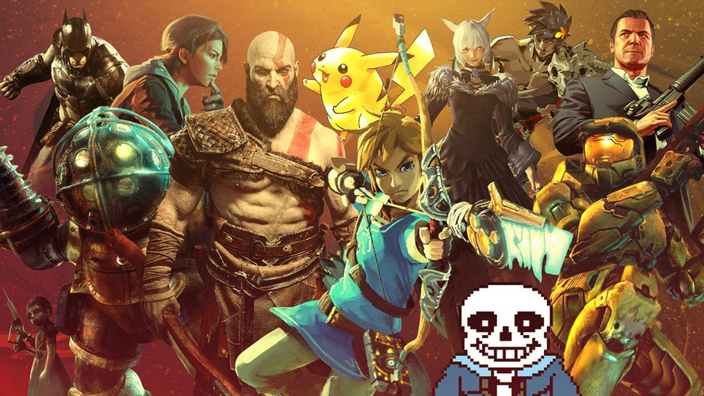
Introduction to Distribution Channels
Physical Media
Discs, cartridges, SD cards, etc.
Sold at retail stores and video game stores
Often treated as collectables
Gamestop, Walmart, etc.
Digital Downloads
Extremely accessible
Multitude of online storefronts
Steam, Epic Games, etc.
Streaming Services
“Stream” video games from the cloud
Analogous to Netflix, Hulu, etc.
Xbox Cloud Gaming, Stadia, Playstation Plus Premium
Platform-Specific
Consoles typically have set of exclusive games
Console companies have deals with certain developers
God of War, Halo, Legend of Zelda, Vader Immortal, etc.
Apple App Store
Quality control
iOS devices
Microsoft Store
Integrated with Xbox
Cross-platform

Slide 3
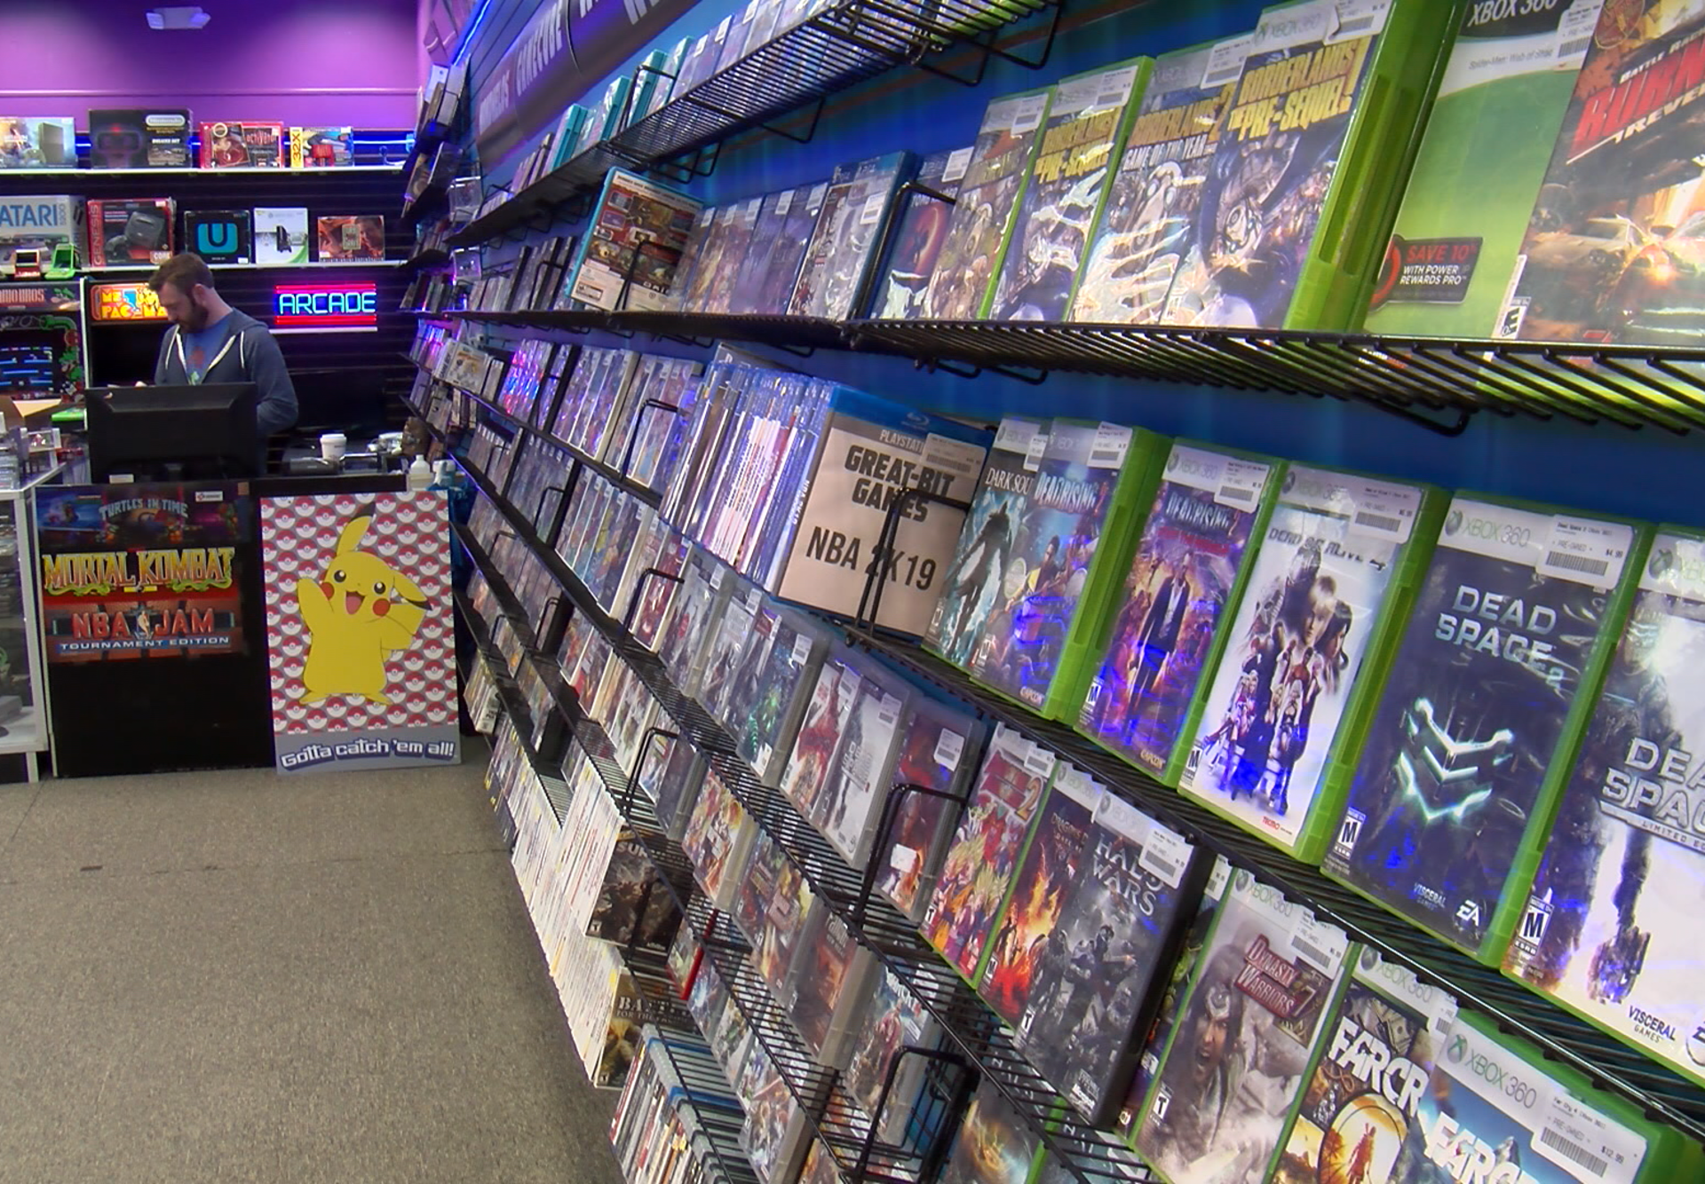
Physical Media
Pros
Ownership
Valued as collectibles
Has a “feel” that non-physical media can’t replicate
Cons
Inaccessible
Have to manage physical costs and resources

Slide 4


Digital Downloads
You might like to do this because it is simple because you do not have to go to the store to buy it and it is easier to switch between games faster because you do not have to switch out game cards or discs. But maybe you wouldn't want to go the digital downloads route because you like to own your games or you like the look of the game cases, the digital downloads are also internet dependent which might be hard for some people who have bad internet or on a road trip.

Slide 5
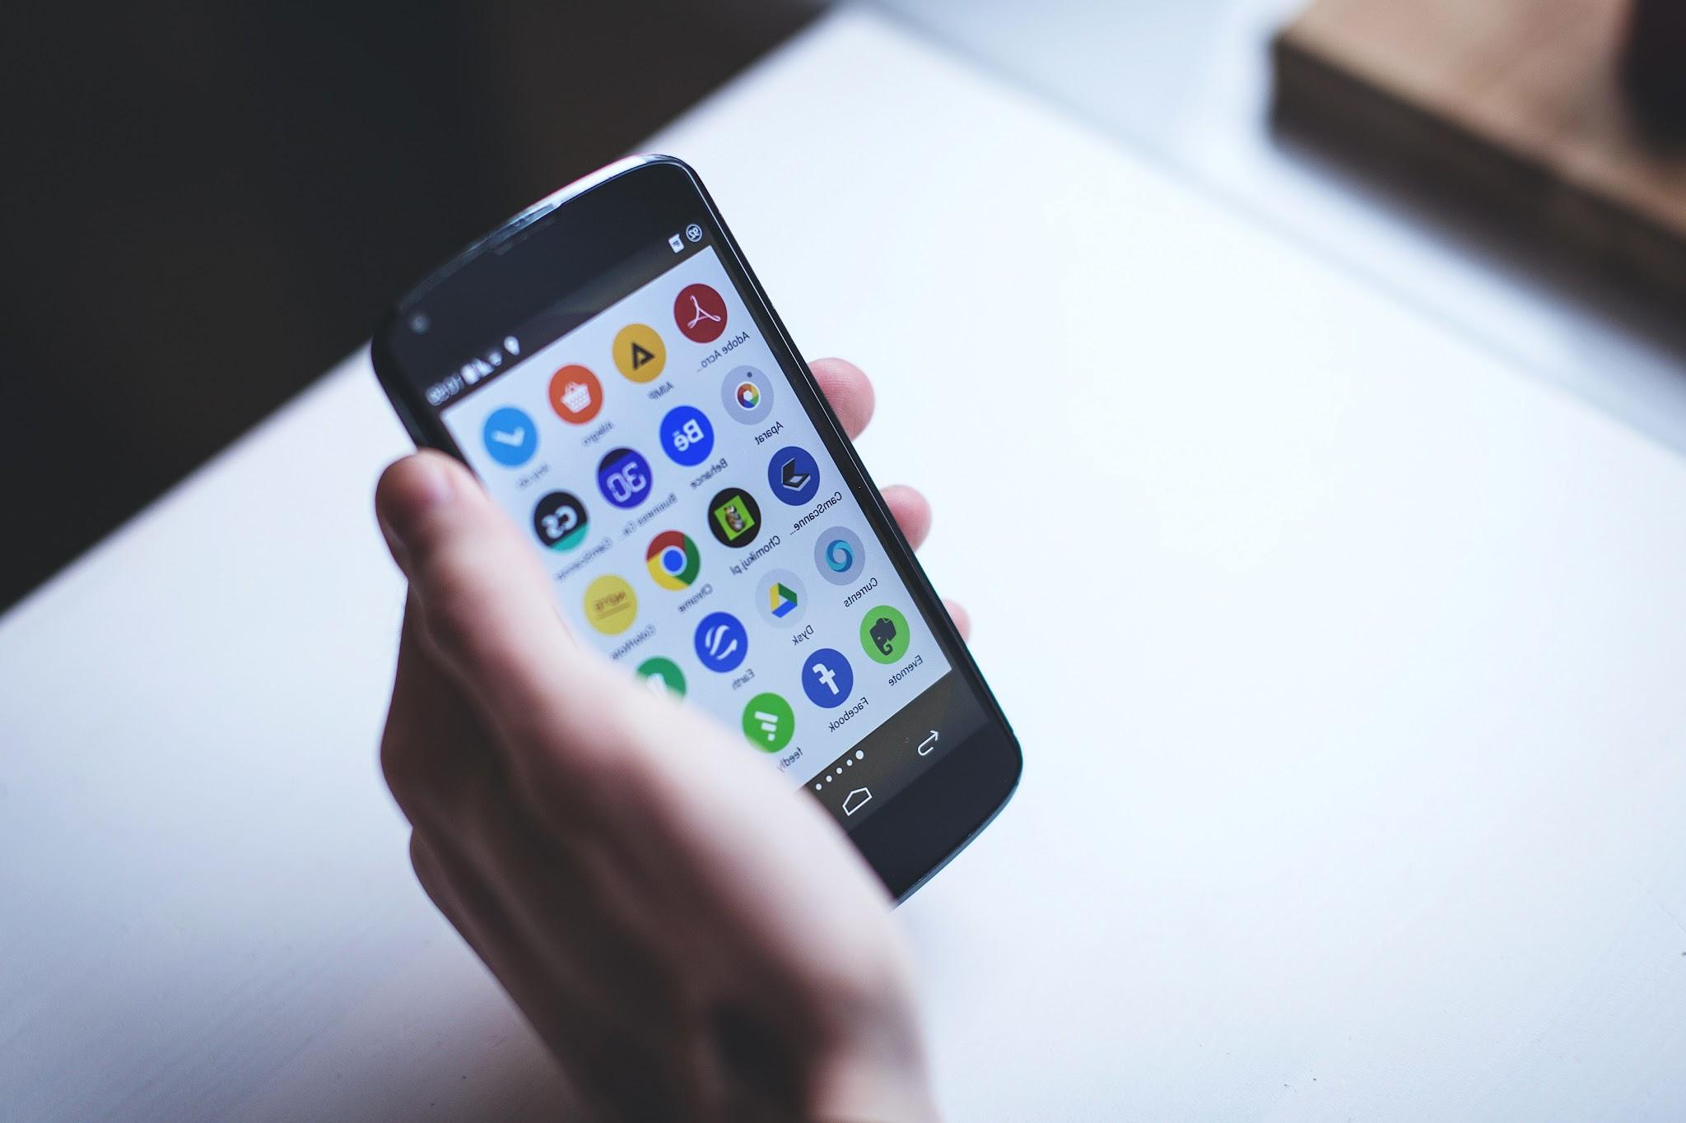

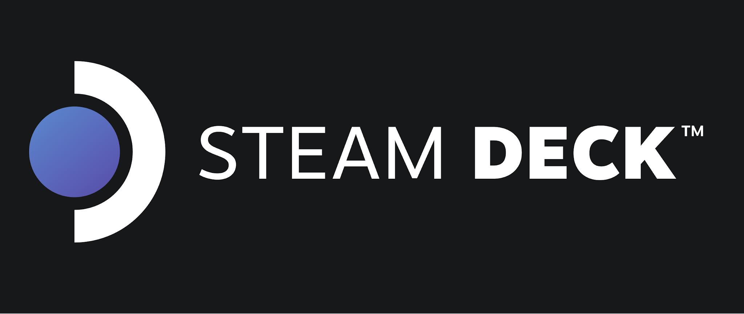
Streaming Services
Play anywhere
Controller and keyboard
On consoles and PC
And mobile (as long as you have a controller)

Slide 6


Platform-Specific Analysis
Only on one system
Free games with subscription
More system sales
Less game sales overall

Slide 7
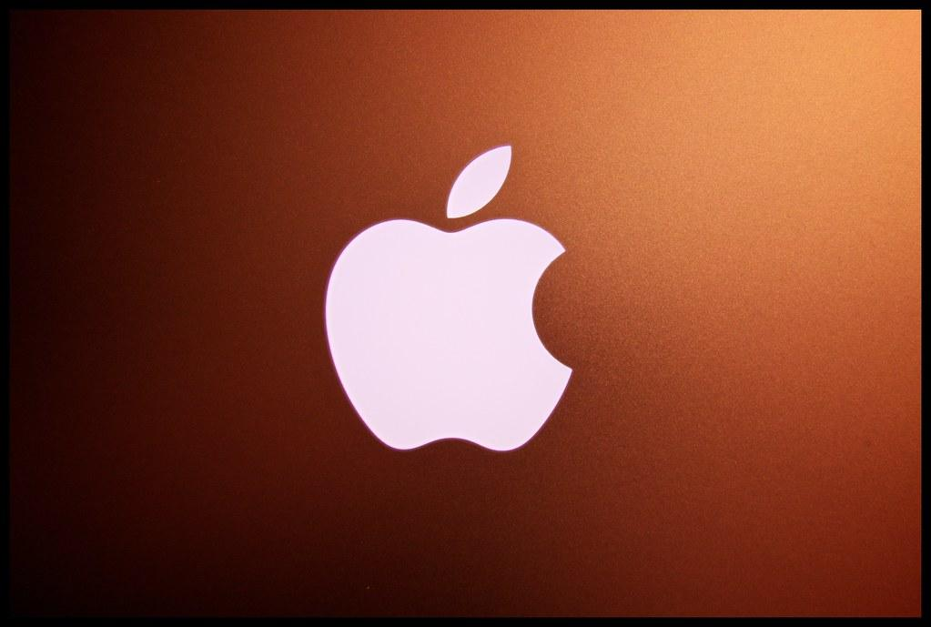
Apple App Store
Lots of availability
Low quality
Lots of apps
Pay apple a percentage

Slide 8


Microsoft store
We do believe that our game has a lot of potential and that we could get it on to Xbox or the Microsoft store with time the only problem we are currently facing is the district trouble with Unity. We don’t think it would be possible for cross platform play just because for now its a single player game and there's no need for it.

Slide 9

Conclusion
In conclusion we are going to do digital downloads. It has the least drawbacks in our opinion along with devices such as the steam deck making you able to play almost anywhere.

Slide 10
Citations
The Gamer
CBS6
Asurion
IGN

